Slide 1

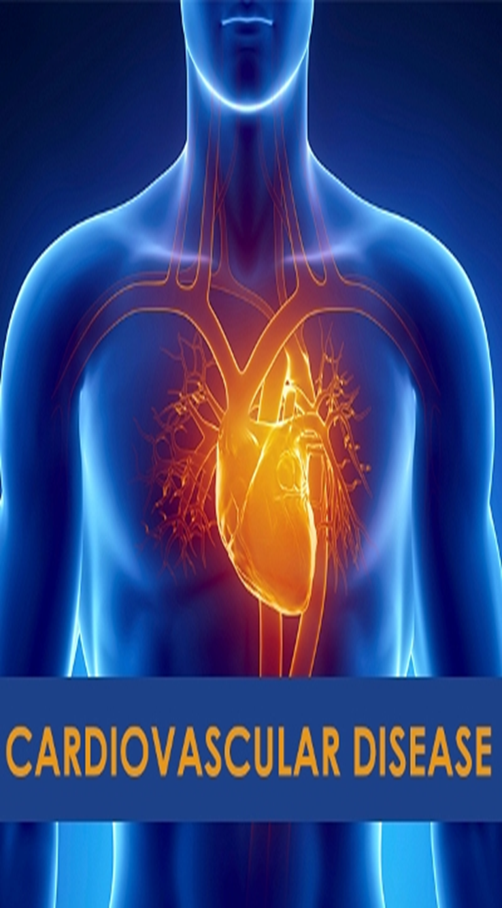
Detection of Cardiovascular Disease using ECG images with Deep Learning methods.
Domain : Deep Learning
Team Members:
1.Akshay raj Vadde , Roll No.:2451-20-733-145
2.Mandadi Rohit Reddy, Roll No.:2451-20-733-159
3.Mahendra Sai Pavan Immadi, Roll No.:2451-20-733-173
GUIDE : M.Madhuri
Assistant Professor

Slide 2
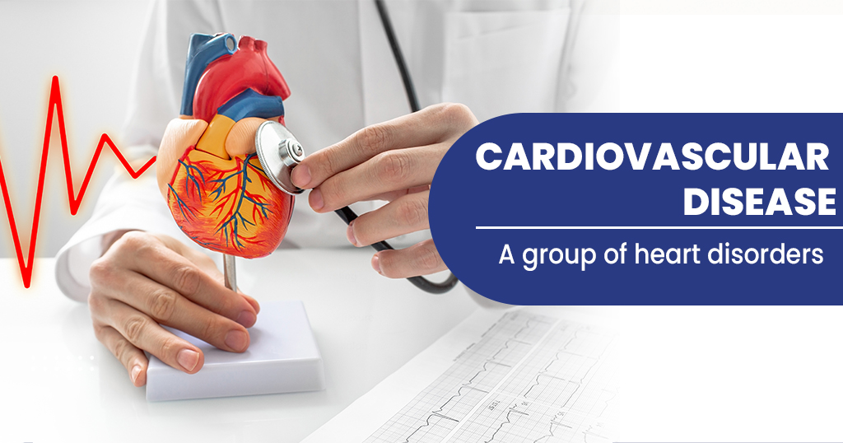
Introduction
According to statistics by the World Health Organization (WHO), each year 17.9 million deaths occur worldwide, all as a result of cardiovascular diseases. Being a major concern requiring urgent attention, numerous methods and research have been carried out in order to establish the most favorable approaches in this very crucial area of medicine most of these cardiovascular related diseases can however be controlled through earlier detection as well as risk evaluation and prediction. The data obtained his then used to derive more knowledge in the field as well as improvise different and innovative approaches necessary for the improvement of health services provided.
Cardiovascular disease (CVD) is a broad term that encompasses a range of conditions affecting the heart and blood vessels. Understanding the fundamentals of CVD is crucial for early detection and effective management.

Slide 3
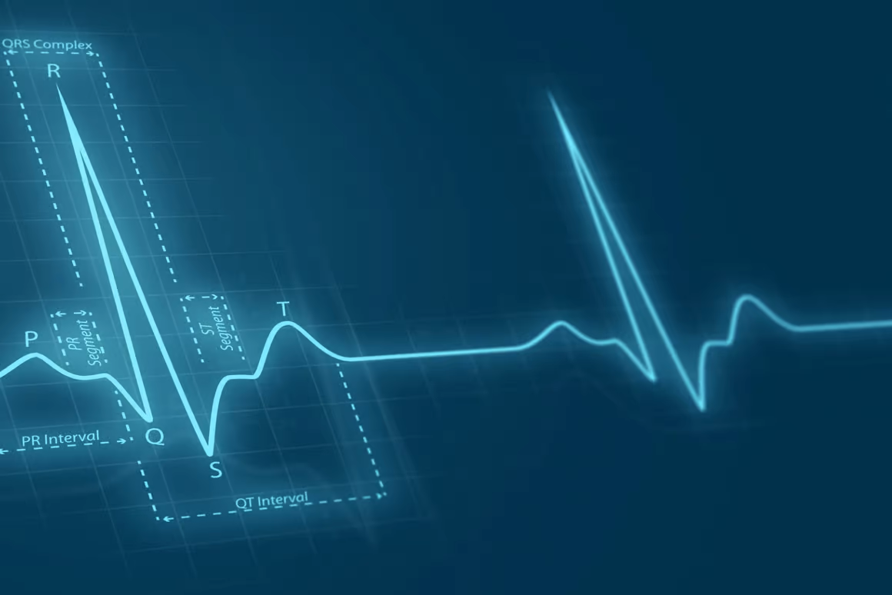

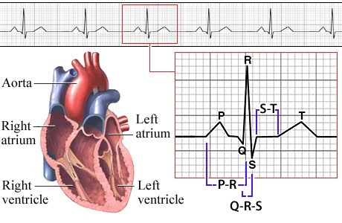
Abstract
Cardiovascular diseases (heart diseases) are the leading cause of death worldwide. The earlier they can be predicted and classified; the more lives can be saved. Electrocardiogram (ECG) is a common, inexpensive, and noninvasive tool for measuring the electrical activity of the heart and is used to detect cardiovascular disease. In this project, the power of deep learning techniques was used to predict the four major cardiac abnormalities: abnormal heartbeat, myocardial infarction, history of myocardial infarction, and normal person classes using the public ECG images dataset of cardiac patients. study compares the performance of the CNN model with existing works, monstrating superior results in terms of accuracy, recall, precision, and F1 score.
The Gaussian filter is used for blurring or smoothing an image. It helps reduce noise and detail in an image, making it more suitable for subsequent processing steps. Otsu's method is a thresholding technique used to automatically determine the optimal threshold value for image segmentation. It separates an image into foreground and background based on the intensity distribution.
XGBoost, an optimized distributed gradient boosting library, is highlighted for its efficiency and scalability in training machine learning models, making it a valuable tool for ensemble learning and improving prediction accuracy.

Slide 4
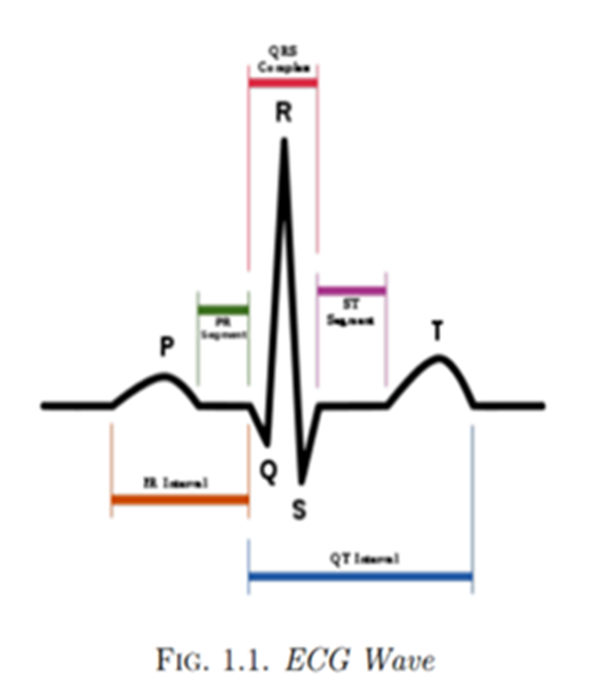
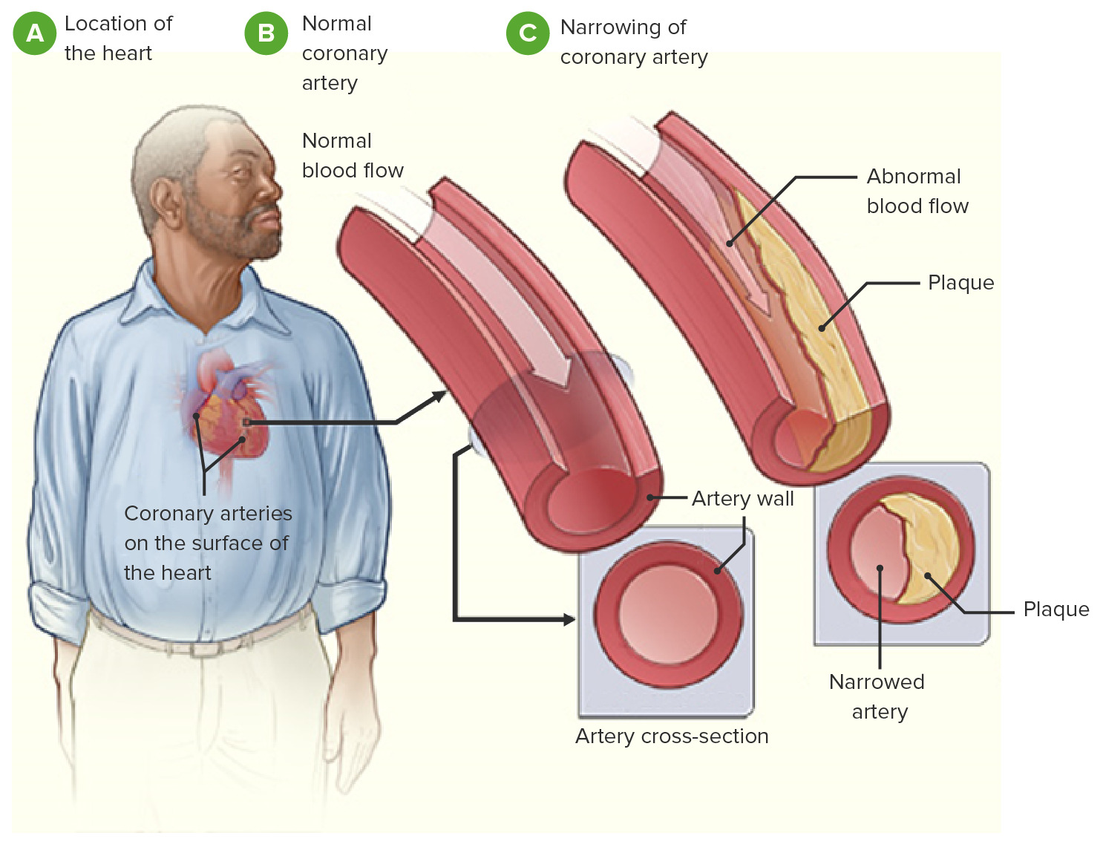
Overview of ECG (Electrocardiogram) Imaging
What is an ECG?
ECG Waveform Analysis
Importance in CVD Diagnosis
An ECG is a non-invasive test that records the electrical activity of the heart, providing valuable insights into its function and potential abnormalities.
Trained professionals analyze the ECG waveform to detect patterns indicative of various cardiovascular conditions, such as abnormal heartbeat, myocardial infarctions, and more.
ECG imaging is a crucial tool in the early detection and monitoring of cardiovascular disease, enabling timely intervention and improved patient outcomes.

Slide 5
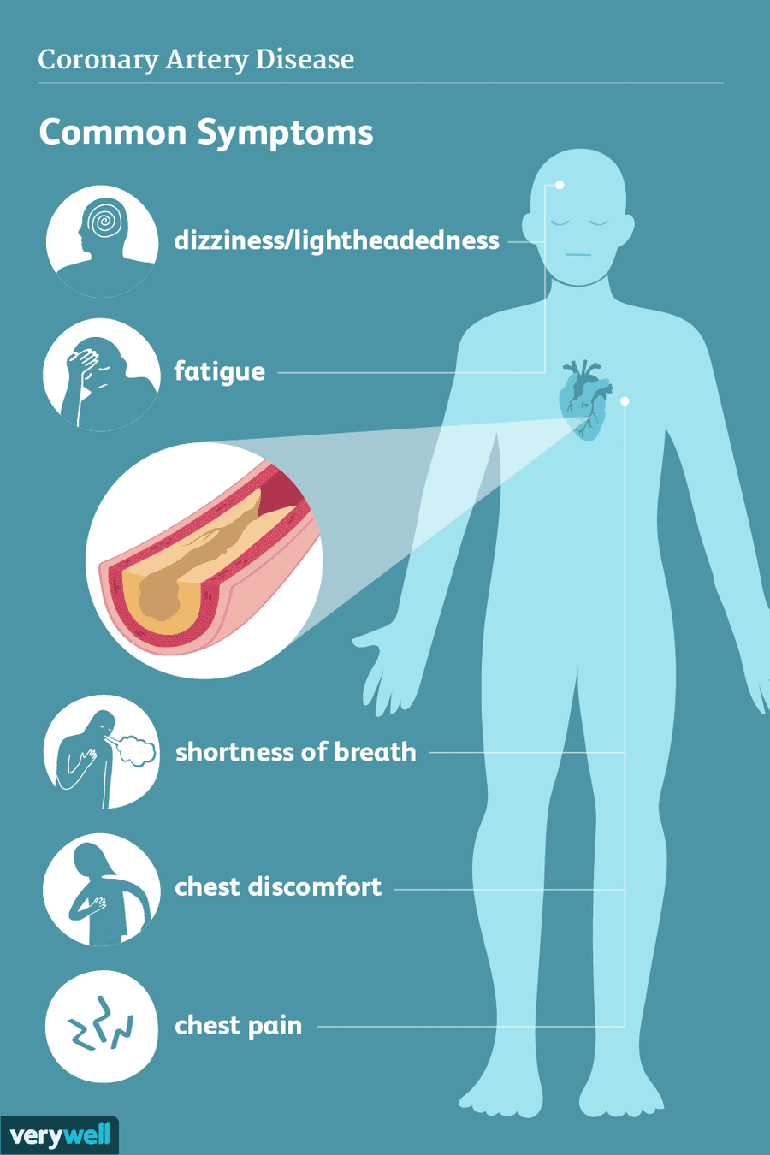
Challenges in Cardiovascular Disease Detection
1
Complexity of CVD Manifestations
2
Limitations of Traditional Approaches
Cardiovascular disease can present with a diverse range of symptoms, making it challenging to accurately diagnose and differentiate from other conditions.
Conventional diagnostic methods, such as manual ECG interpretation, can be time-consuming, subjective, and prone to human error, highlighting the need for more robust solutions.
3
Improving Early Detection
Developing advanced techniques, like deep learning, can enhance the accuracy and speed of CVD detection, leading to earlier interventions and better patient outcomes.

Slide 6
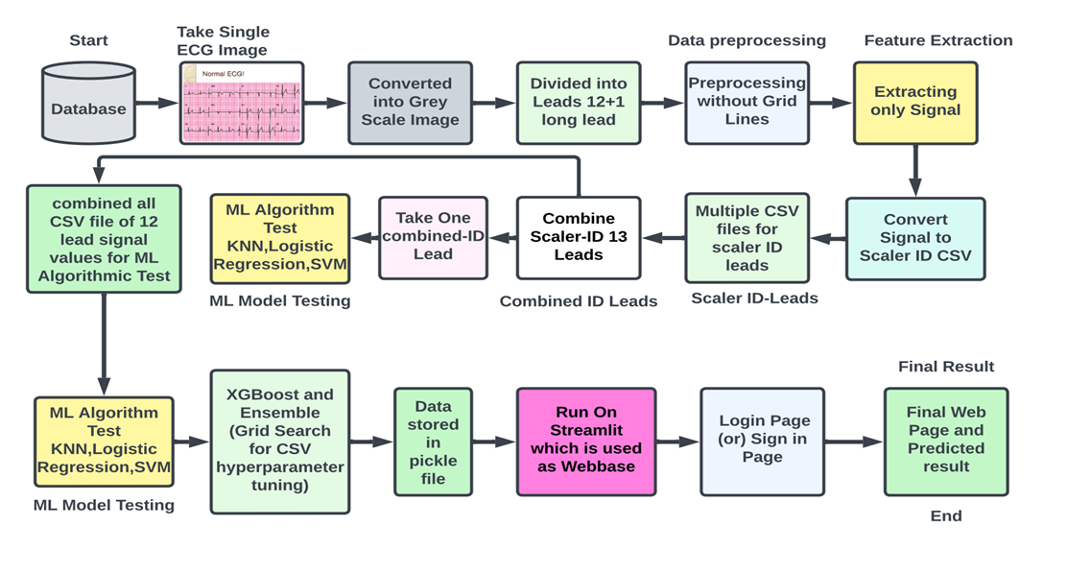


System Architecture

Slide 7
Data Preprocessing and Image ProcessingTechniques
Noise Reduction (Gaussian Filter)
Image Processing
Applying signal processing techniques to remove noise and artifacts from ECG data can improve the reliability of deep learning models.
Image Processing is the field of study and applicaton that deals with modifying and anlyzing digital images using computer algorithms. The goal of image processing is to enhance the visual quality of images.
Feature Engineering
Dataset Balancing
Extracting and selecting relevant features from ECG signals can enhance the performance of deep learning models in cardiovascular disease detection.
Addressing imbalances in the dataset, such as an over-representation of healthy samples, can ensure the model learns to accurately identify all classes of cardiovascular conditions.

Slide 8
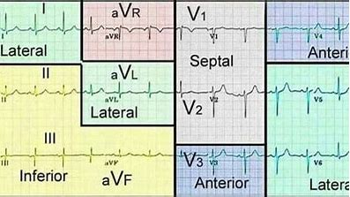
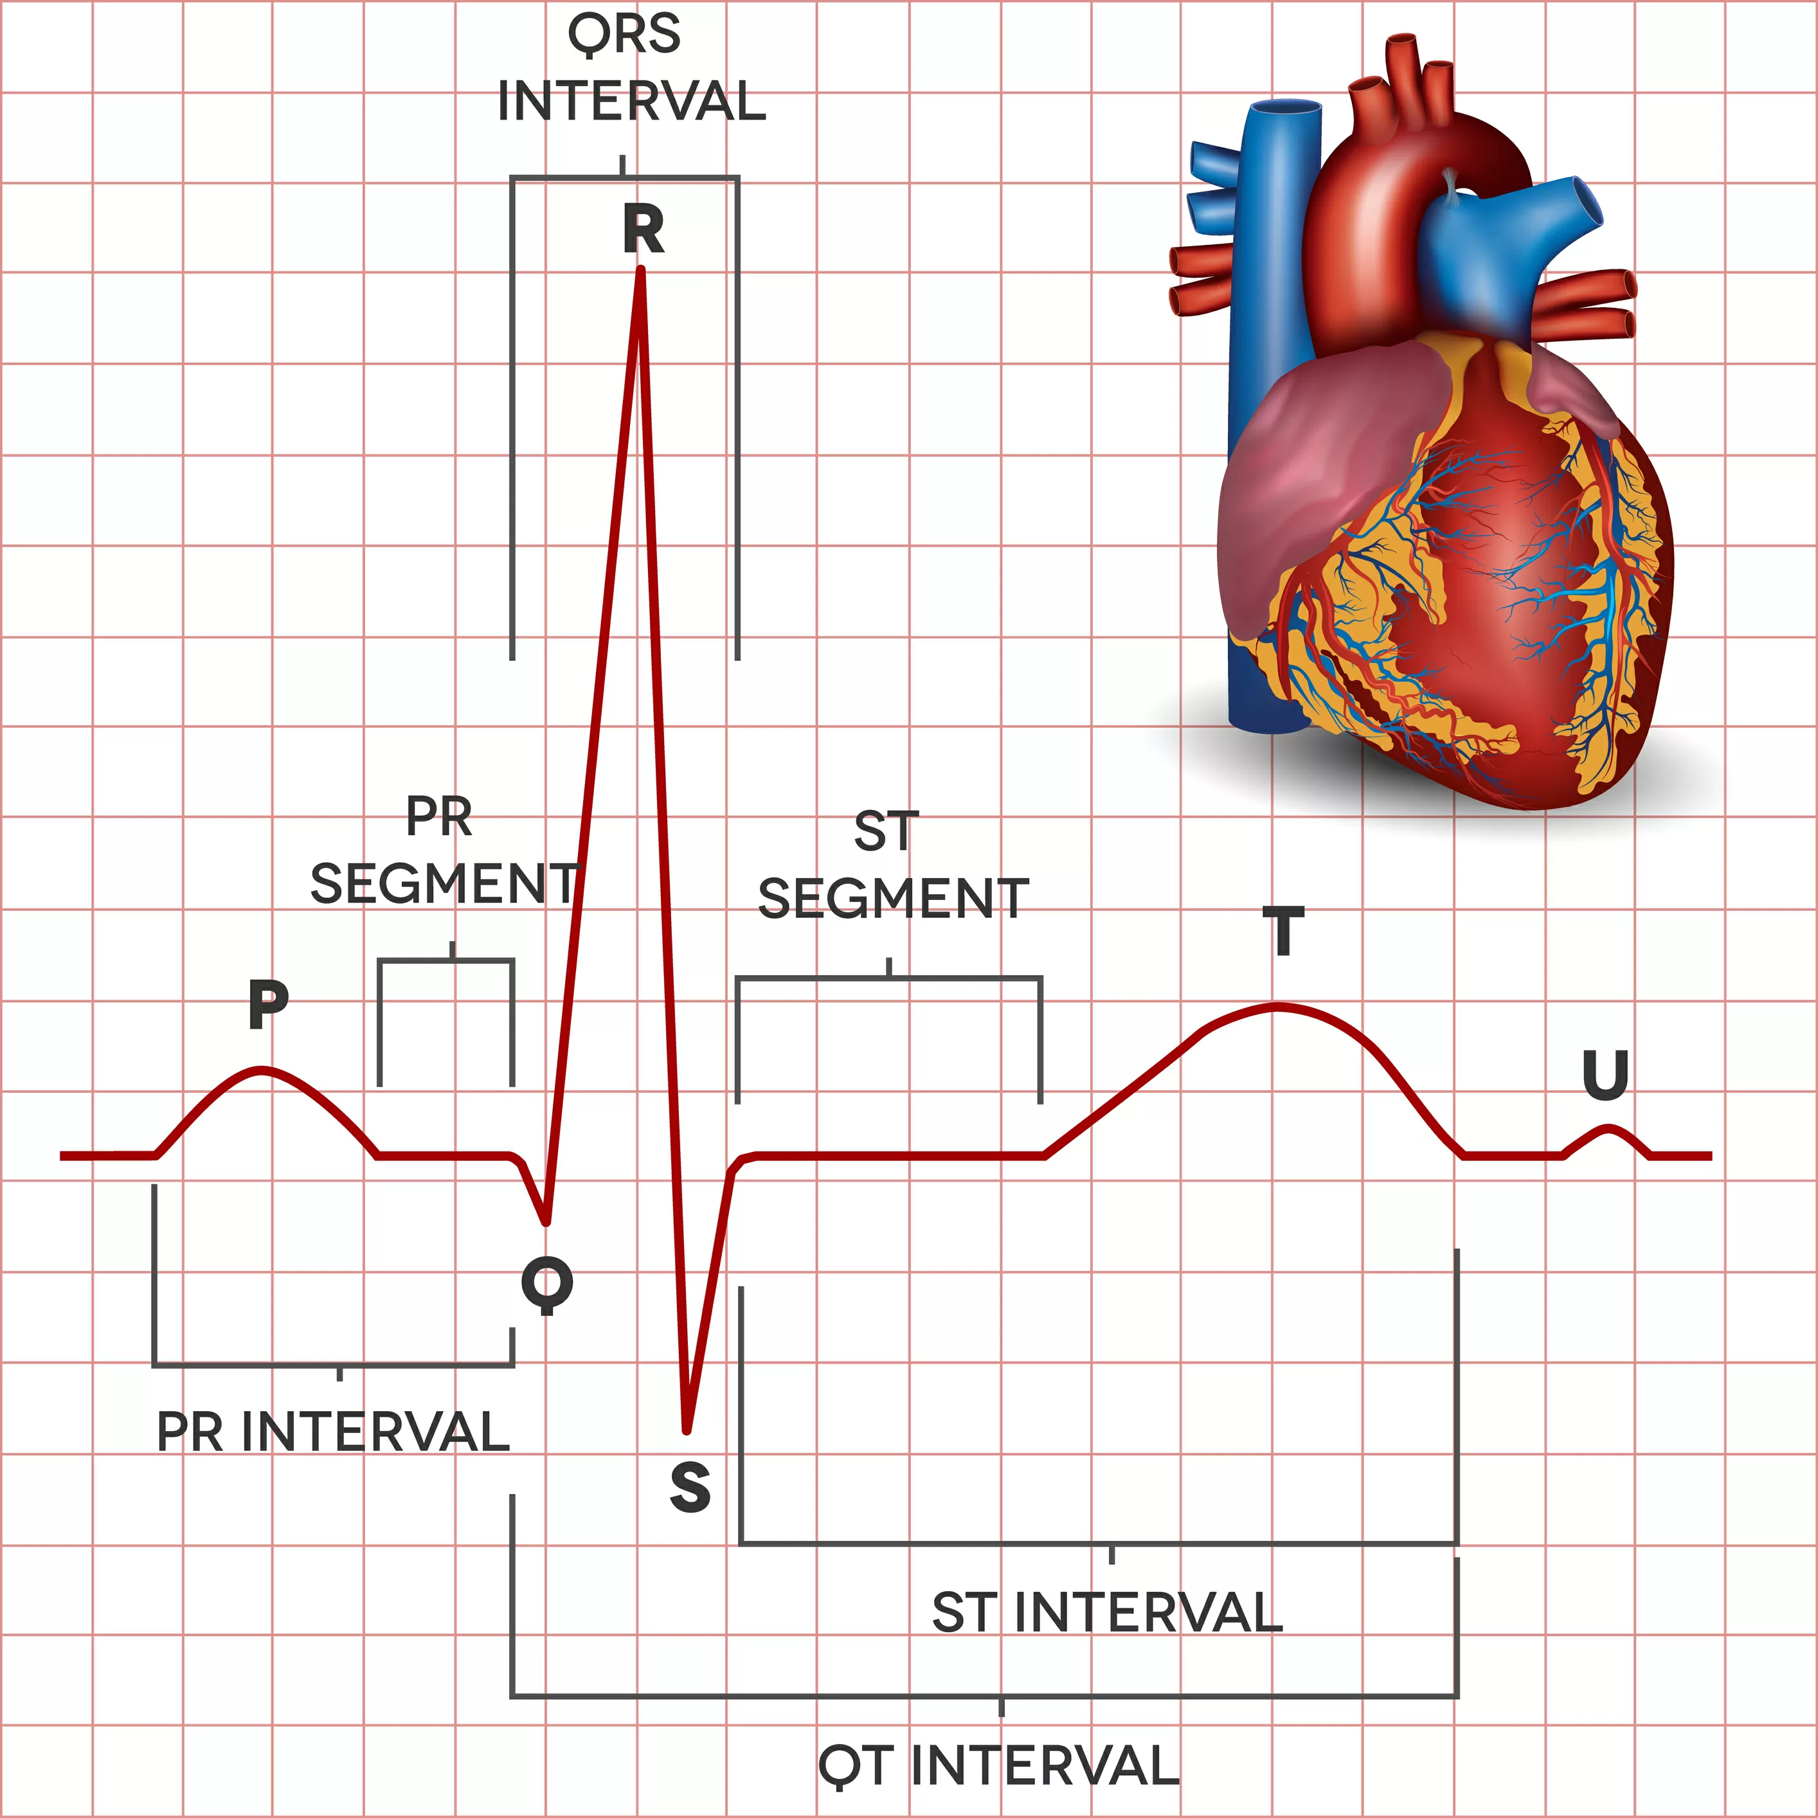
Deep Learning Approaches for ECG Analysis
1
Feature Extraction
Deep learning models can automatically extract relevant features from ECG waveforms, eliminating the need for manual feature engineering.
2
Pattern Recognition
These models excel at identifying complex patterns in ECG data, which can be indicative of various cardiovascular conditions.
3
Automated Classification
Deep learning algorithms KNN, Logistic regression, Support Vector Machine can accurately classify ECG signals into different categories, such as normal, abnormal heartbeat, myocardial infarction and patient history with myocardial infarction and supporting rapid diagnosis.

Slide 9
Model Architectures for ECG Image Classification
Convolutional Neural Networks
ML Algorithms
Principle Component Analysis
Ensemble Methods
Leveraging the spatial and temporal features of ECG signals, CNN-based models have shown promising results in cardiovascular disease detection.
Machine Learning algorithms are computational models that allow computers to understand patterns and forecast to make judgements based on data without the need for explicit programming.
Principal Component Analysis (PCA) is a statistical procedure in machine learning that uses an orthogonal transformation to convert a set of observations of possibly correlated variables into a set of values of linearly uncorrelated variables called principal components. This technique is used to emphasize variation and bring out strong patterns in a dataset.
Combining multiple deep learning models through techniques like bagging or boosting can further enhance the accuracy and robustness of cardiovascular disease detection.

Slide 10
Performance Evaluation and Metrics
Metric
Description
Importance
Accuracy
The proportion of correct predictions made by the model
Provides an overall measure of the model's performance
Precision
The ratio of true positive predictions to total positive predictions
Crucial for minimizing false-positive diagnoses
Recall
The ratio of true positive predictions to all actual positive instances
Vital for ensuring high detection rates of cardiovascular conditions
F1-Score
The harmonic mean of precision and recall, balancing the two metrics
A comprehensive metric that captures both precision and recall

Slide 11
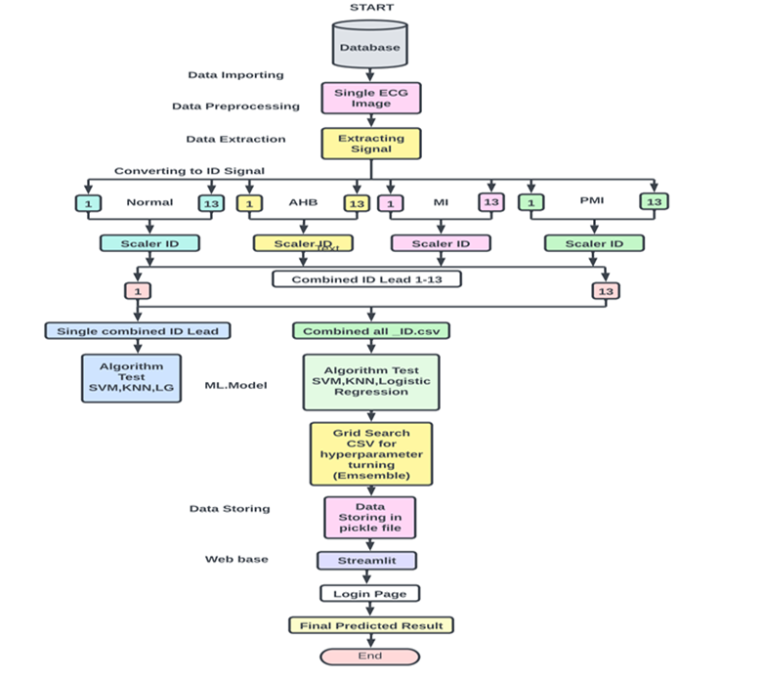

Technologies Used In This Project
1
Technologies Used:
2
Libraries used:
Skimage, matplotlib, NumPy, Scipy.nd_image, Pandas, SkLearn, Natsort,joblib, XGBoost, Ensemble, Pickle, Local tunnel etc.
Colab, Streamlit , Localtunnel, etc.
3
Applications(ML Algorithms):
1.K-Nearest Neighbour(KNN)
2.Logistic Regression
3.Support Vector Machine(SVM)
4.XGBoost
5. Voting Based Ensemble Classifier with GridSearchCV
6.Streamlit
Developing advanced techniques, like deep learning, can enhance the accuracy and speed of CVD detection, leading to earlier interventions and better patient outcomes.

Slide 12
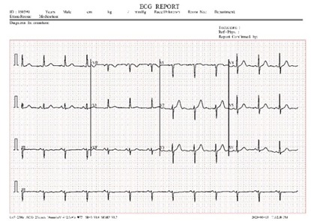

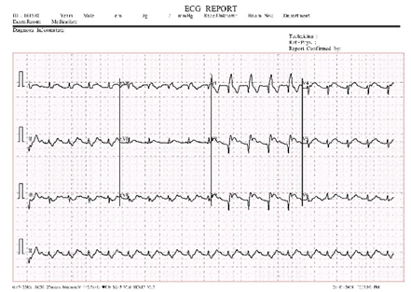

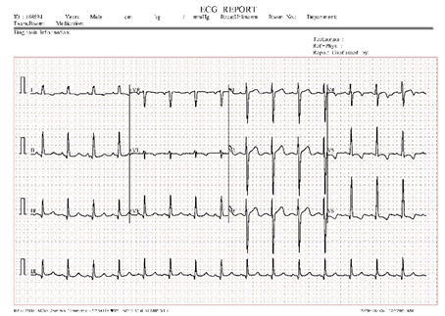


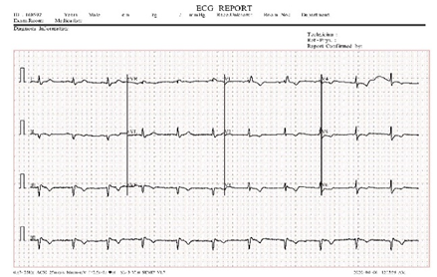

Used Dataset:
ECG images: https://data.mendeley.com/datasets/gwbz3fsgp8/2
The above dataset contains ECG image signals from both healthy individuals and persons with cardiovascular problems.
The dataset contains 4 categories of ECG images:
1
Normal Person ECG Images (284x12=3408)
2
ECG Images of Myocardial Infarction Patients (240x12=2880)
3
ECG Images of Patient that have abnormal heartbeat
(233x12=2796)
4
ECG Images of Patient that have History of MI (172x12=2064).
(Total Images of data set= 11,148)

Slide 13
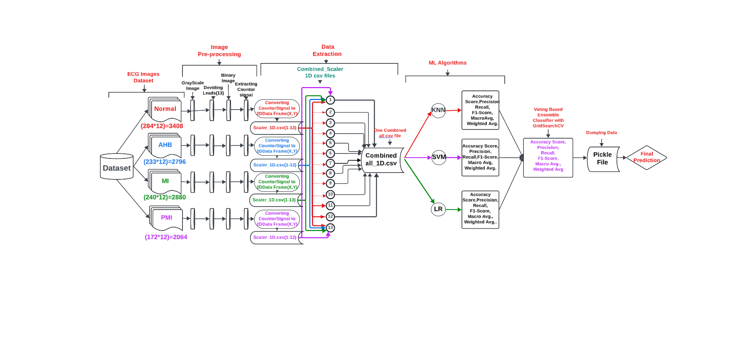
CNN BASED ECG IMAGE CLASSIFICATION

Slide 14
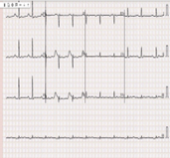
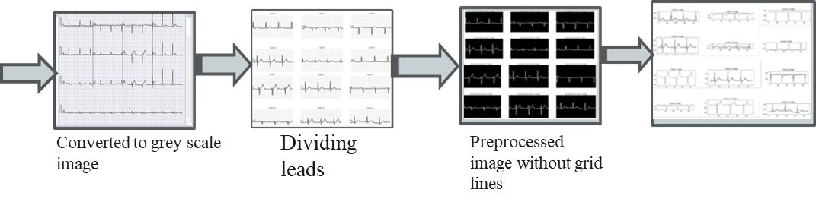
Project Work: Data Pre-Processing
Converted all ECG images to grayscale
Resized image per requirements
Divided the images into 12 sections for each image extracting 12 lead values (1-12)
Removed Grid lines from each lead image and converted to binary image
Extracted the contour (2D) signal
ECG Image
Converted to grey scale image
Dividing Leads
Pre-processed Image
Extract the Countor 2D Signal

Slide 15
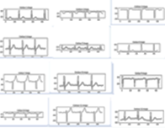
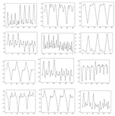
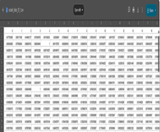

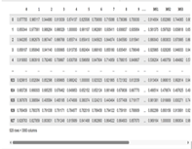

1D_Data stored in Scaler_data_1D.csv
(Normal,HB,MI,PMI)
Project Work:Data Extracting
To trace and extract only the necessary 2D-signal from images, we used the contour technique.
MinmaxScaler is used to scale the image.
After that, The image is converted to a one-dimensional signal.
For each lead(1-12) signal in all ecg image, saved the 1D signal values in a.csv file.
In a single csv file, combined all 12 lead values with the added target label.
Scaler_1D _Lead_signal
1D_Data stored in Scaler_data_1D.csv
(Normal,HB,MI,PMI)
Combining
scaler_1D.csv data
Combining all
Combined
scaler_1D.csv
data stored in single csv file
Extract the contour (2D) signal

Slide 16



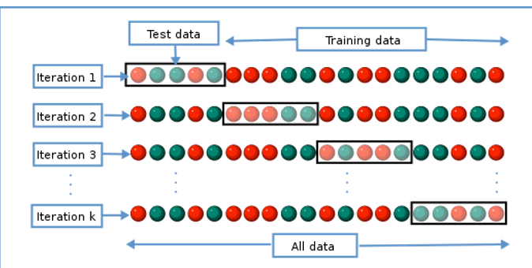
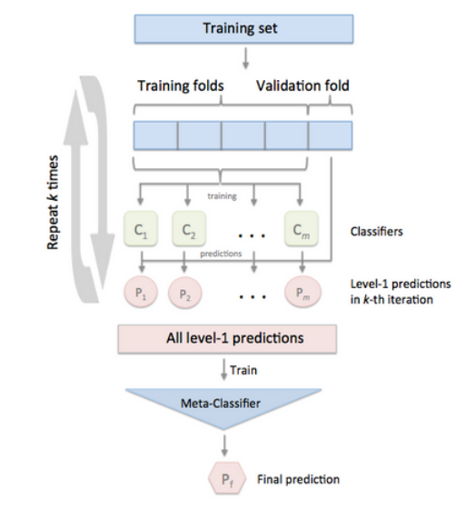
ML Model
We tested various algorithms and then utilized the ensemble technique to stack algorithms to enhance performance because it was a classification problem.
ML Algorithms tested
GridSearchCv for
Hyperparamter Tuning
Ensemble of stacking multiple models using voting classifier
PCA
Knn
Logistic Regression
SVM
XGBoost
Ensemble

Slide 17
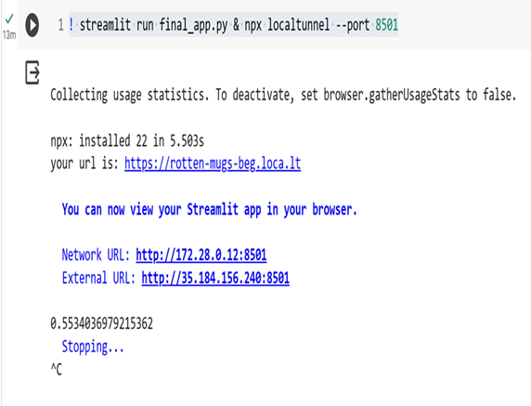

Streamlit Output
IP Address generated
Website (Localtunnel)
The promising results of deep learning in ECG-based cardiovascular disease detection highlight the immense potential for this technology to revolutionize cardiac care and improve patient outcomes.

Slide 18
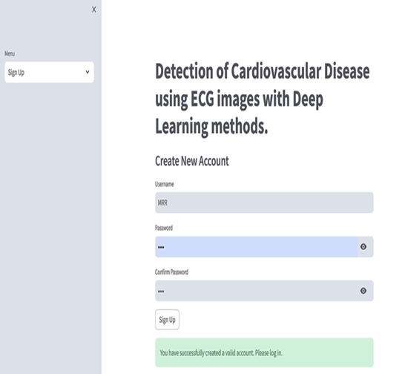
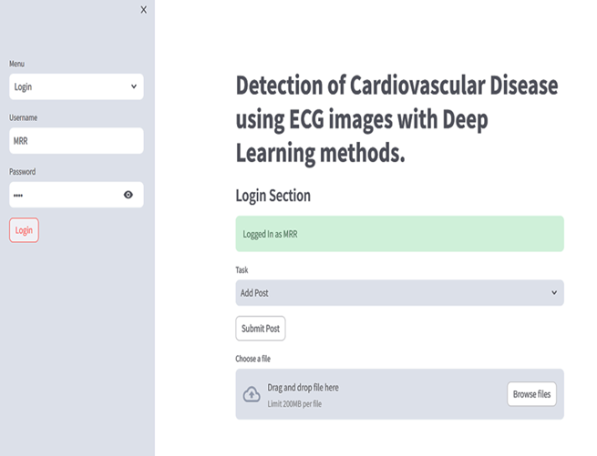
Final Predicted Results
Sign Up Page
Login Page
The promising results of deep learning in ECG-based cardiovascular disease detection highlight the immense potential for this technology to revolutionize cardiac care and improve patient outcomes.

Slide 19
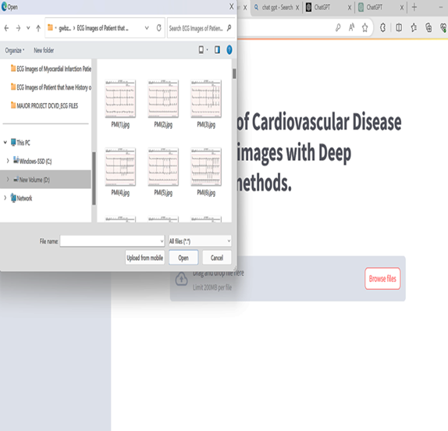
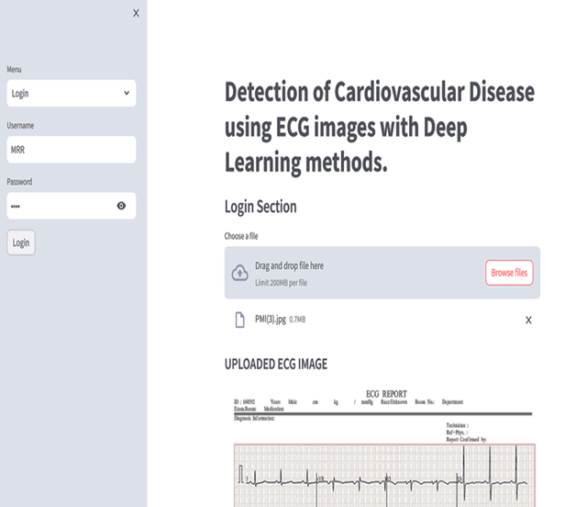
Choose ECG Image for prediction
Browse the ECG file
The promising results of deep learning in ECG-based cardiovascular disease detection highlight the immense potential for this technology to revolutionize cardiac care and improve patient outcomes.

Slide 20
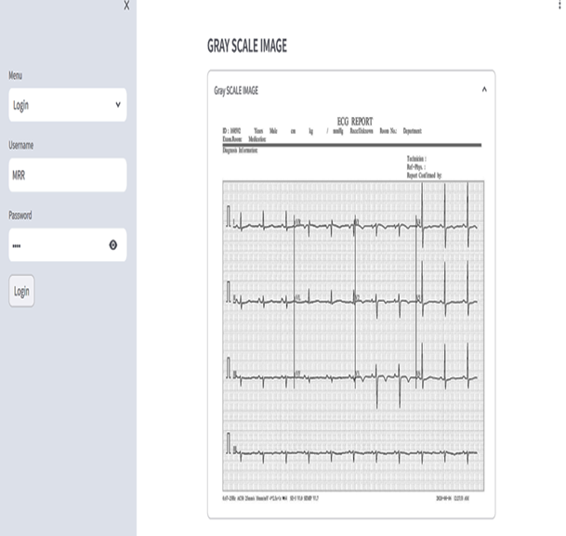
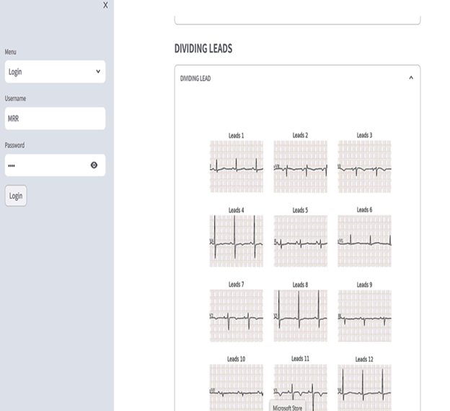
Gray Scale Image
Dividing Leads (1-13)
The promising results of deep learning in ECG-based cardiovascular disease detection highlight the immense potential for this technology to revolutionize cardiac care and improve patient outcomes.

Slide 21
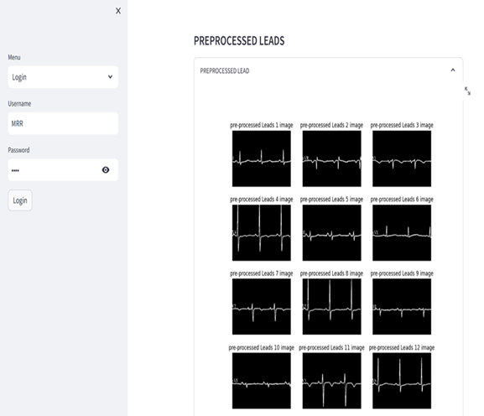
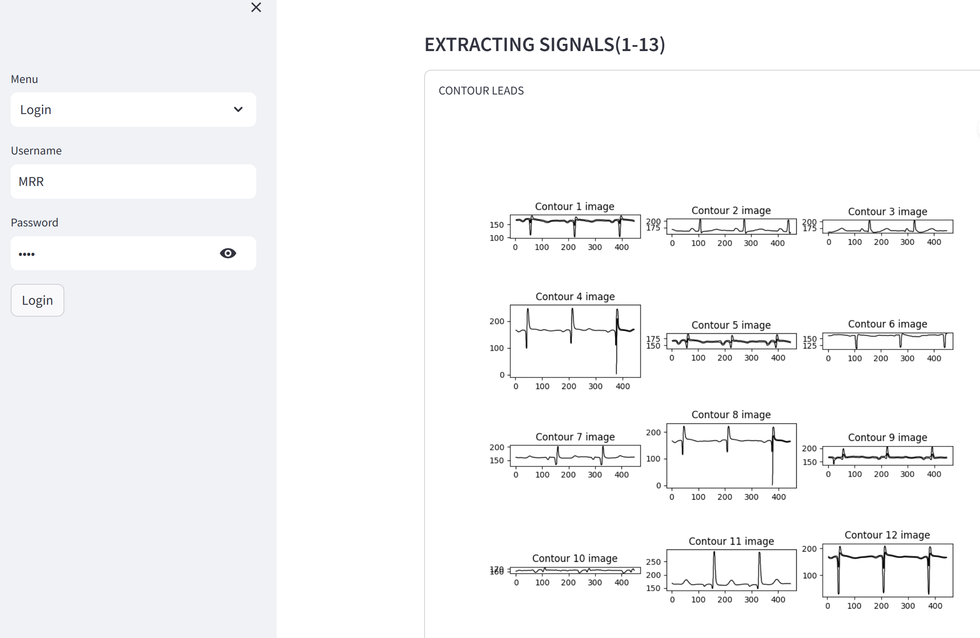
Processed Leads
Extracting Contour Signals
The promising results of deep learning in ECG-based cardiovascular disease detection highlight the immense potential for this technology to revolutionize cardiac care and improve patient outcomes.

Slide 22
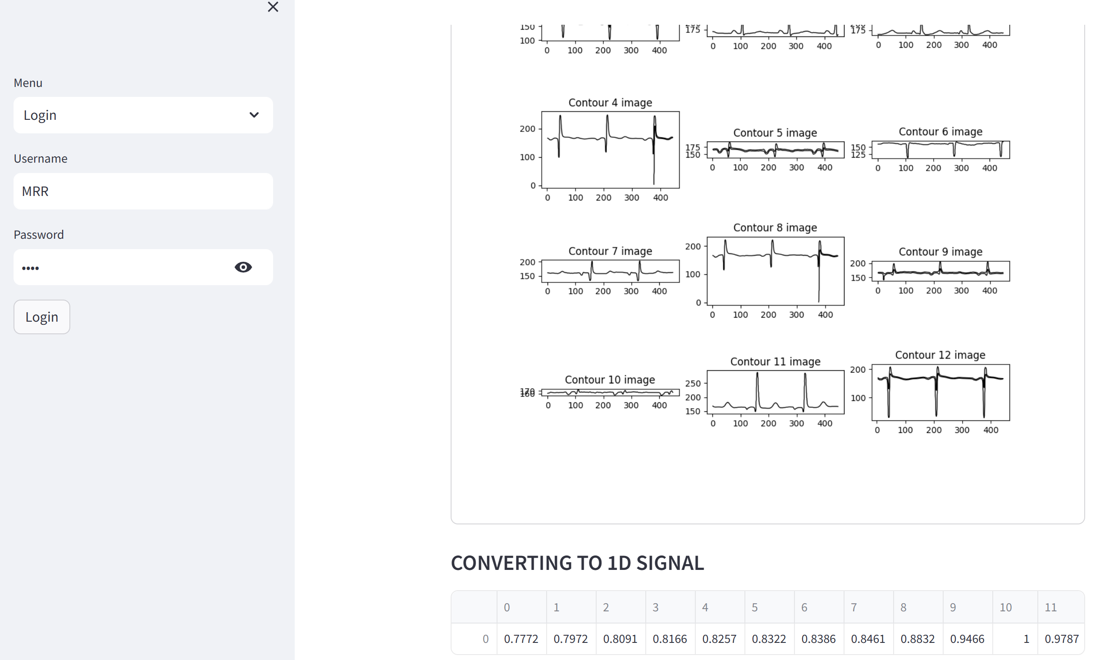
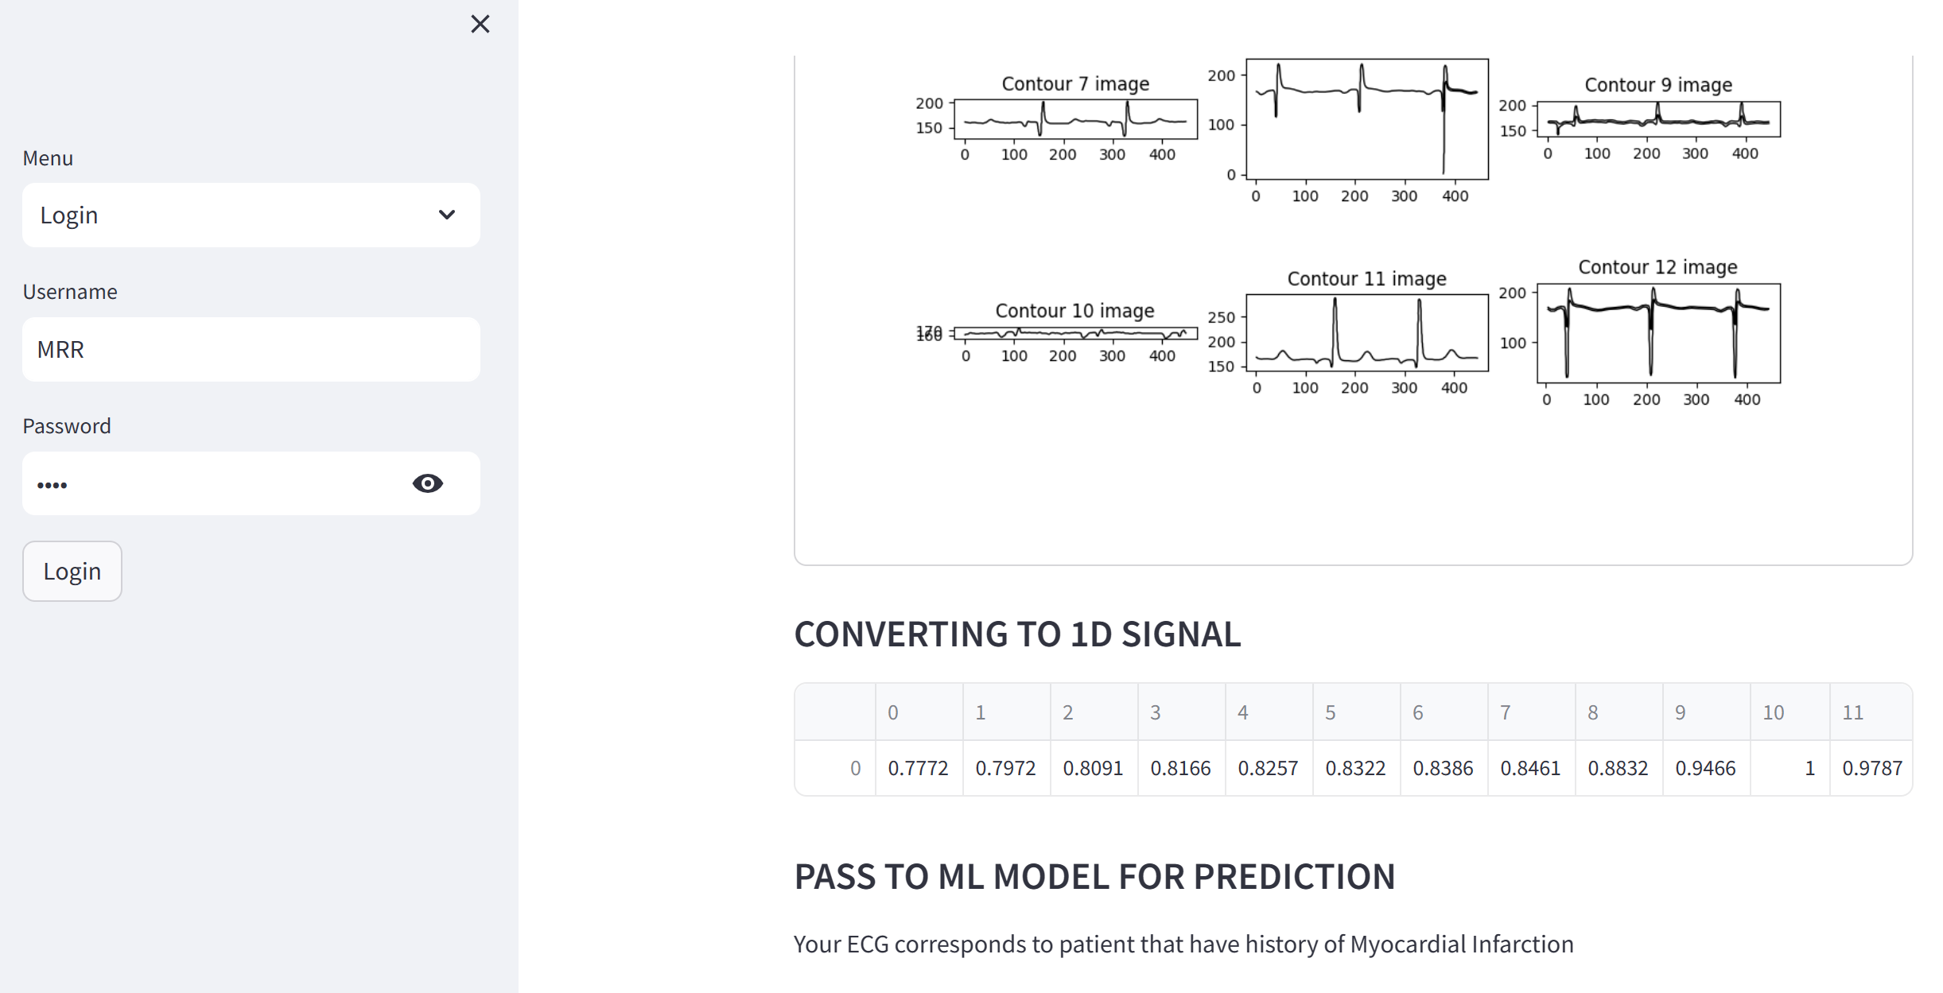
Converting Contour Signal to 1D Signal csv data
Final Predicted Result
The promising results of deep learning in ECG-based cardiovascular disease detection highlight the immense potential for this technology to revolutionize cardiac care and improve patient outcomes.

Slide 23
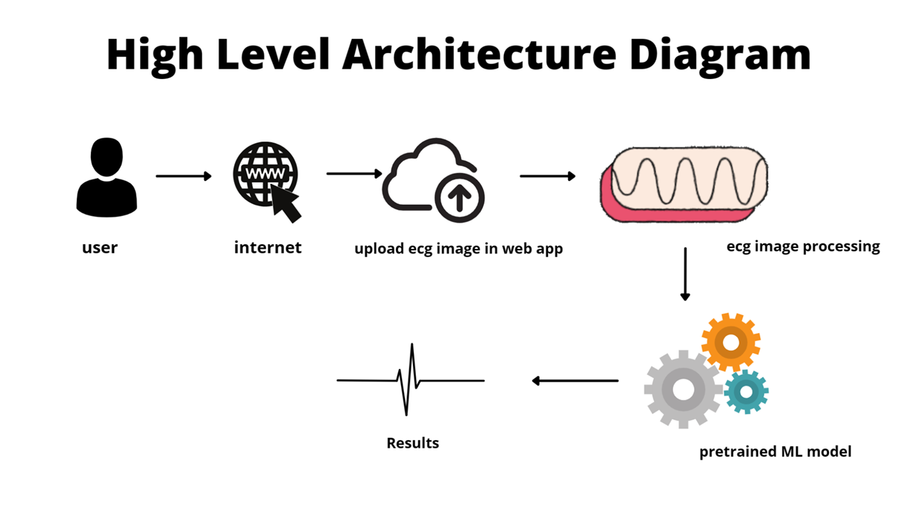
The promising results of deep learning in ECG-based cardiovascular disease detection highlight the immense potential for this technology to revolutionize cardiac care and improve patient outcomes.

Slide 24

Conclusion and Future Directions
Improved Accuracy
Seamless Integration
Personalized Medicine
Continued advancements in deep learning architectures and training techniques will lead to even more accurate cardiovascular disease detection from ECG data.
The integration of deep learning-based ECG analysis into clinical workflows will streamline diagnosis and monitoring, enhancing patient care.
Leveraging deep learning for ECG analysis can enable the development of personalized treatment strategies, tailored to individual patient characteristics and disease profiles.
The promising results of deep learning in ECG-based cardiovascular disease detection highlight the immense potential for this technology to revolutionize cardiac care and improve patient outcomes.

Slide 25


